Slide 1
Level up with PowerShell
Josh Rickard

Slide 2
Welcome!
Introductions
Break Times
Housekeeping

Slide 3
Josh Rickard
Helpdesk
System Support
Security Analyst
Product Management

Slide 4
About This Course
Utilizes Learn Windows PowerShell 3 in a Month of Lunches (http://bit.ly/PSHv3Lunch)
Focuses on how to use PowerShell, rather than on using PowerShell for any one specific product (e.g., Exchange or SharePoint)
Provides the foundation skills you need to be immediately effective with PowerShell, and to self-teach whatever specific products you need to administer.

Slide 5
Now you!

Slide 6
Versions

Slide 7
PowerShell Versions
V2
WinXP+, Win2003+
V3
Win7+, Win2008+
V4
Win7+, Win2008R2+
V5
Win10+. Win2012R2+

Slide 8
Version 2
Windows XP and Later
Windows Server 2003 or Later
.NET Framework 2.0 (minimum)
.NET Framework 3.5 (optimal)

Slide 9
Version 3
Windows 7 and Later
Windows Server 2008 and Later
.NET Framework 4.0 (Full Install, NOT the client profile)

Slide 10
Version 4
Windows 7 and Later
Windows Server 2008R2 and Later
.NET Framework 4.5

Slide 11
Version 5
Windows 7 and Later
Windows 2008R2 and Later
.NET Framework 5.0

Slide 12
PowerShell V5
Windows 7
Windows 8.1
Windows 10

Slide 13
64-bit OS
4 different versions of PowerShell
Windows PowerShell (x86)
Windows PowerShell ISE (x86)
Windows PowerShell ISE
Windows PowerShell

Slide 14
Additional Features
PowerShell Version features are dependent on a few things
The Host OS
The Feature you are wanting to use
I.e. Exchange, ActiveDirectory, etc.
Native Version installed on OS will have more features than an older OS

Slide 15
PowerShell Console
Notes:
Welcome to the PowerShell Console
Look at the title bar
Make sure you’re running as Administrator
Doesn’t say (x86)
Change the Display/Font
Pick Consolas
Change Font Size
Etc
Change the Layout
Buffer Width 150
Buffer Height 3000
Window Size Width = 150
Height = 33
Accessing other versions of PowerShell
PowerShell –Version 2
PowerShell –Version 3
Etc.

Slide 16
PowerShell ISE
Notes:
Right Click PowerShell Icon and select ISE
Top Pane is Script Pane
Bottom Pane is interactive console pane
Show Layout options
Customize the Theme
Foreground and Background
Talk about Visual Studio Code or PowerShell Studio

Slide 17
Using PowerShell

Slide 18
Finding Commands
CmdLet
This is a keyword for ”Native Commands”
Functions
This is a keyword for added functions
Modules
This is a collection of Functions added to your PowerShell Session

Slide 19
Get-Module
Get-Module –ListAvailable
List all available Modules
Import-module –Name TroubleshootingPack
Loading it into memory
You have to import the module everytime you load PowerShell
Per Process/Per Window case

Slide 20
PowerShell V3
Automatically loads Modules if referenced
Even if you run
Get-Module
And only a few return
When you run Get-Command –Noun *computer*
It will still possibly list out other modules that have not been loaded
These will be loaded at runtime
This is based on a PowerShell Module Path
$env:PSModulePath

Slide 21
PowerShell Module Paths
C:\Users\Administrator\Documents\WindowsPowerShell\Modules\
This location is for PowerShell modules that you have loaded or downloaded from the web
C:\Windows\System32\WindowsPowerShell\v1.0\Modules\
This location is for native PowerShell modules, usually added by adding features or specific programs
i.e. Active Directory Users and Computers, Exchange CmdLets, etc.

Slide 22
Three Crucial Commands
Get-Command

Slide 23
Get-Command
Get-Module –Module TroubleshootingPack
Get-Command -Name *pack*
Get-Command -Name *pack* -CommandType cmdlet,function
Only PowerShell Native stuff
Get-Command –Name *log* -CommandType cmdlet, function

Slide 24
Naming Conventions
Verb-Noun (Singular Noun)
Get-Comamnd –Name *service* -CommandType cmdlet,function
Get-Command –Verb Get –Noun *service*

Slide 25
Anatomy of a Command
Space separates parameter name and value
Dash precedes paramater name
Spaces act as separators
-Name B*
Get-Service –Name B* -ComputerName SERVER1,SERVER2
Comma-separated lists pass multiple values to a parameter
Command
Name
First Parameter
Second Parameter

Slide 26
Question
If you wanted to view a list of running processes, what would the Verb be?
Get
Get-Command –Verb Get –Noun *process*

Slide 27
Tab Completion
Get-Command -Noun netadapteren*
Tab Completion

Slide 28
Alias’s
Get-Command –CommandType Alias
% - Foreach-Object
? – Where-Object
Cat – Get-Content
Cp – Copy-Item
Del – Remove-Item
Gci - Get-ChildItem
Ls – Get-ChildItem
Etc.

Slide 29
Anatomy of a Command
Positional parameters can accept values without providing the parameter name – if you do so in the correct order!
gsv B* -Comp SERVER1,SERVER2
Alias is a “nickname” for the command
All parameter names can be truncated

Slide 30
Finding Help

Slide 31
SEO
CmdLet
Add it to your web search
Microsoft made up this word to help with searching the internet for PowerShell help

Slide 32
Where do I get Modules?
Typically included in your additional software
i.e. Active Directory -> RSAT Tools

Slide 33
Three Crucial Commands
Get-Command
Help

Slide 34
Get-Help
Get-Help –Name dir
Sometimes it will scroll past you
You can use help (alias) instead
This pipes the Get-Help info to the More command
Caveat, help will not always show you help unless you have loaded that module into memory first

Slide 35
Help Switches
Get-Help dir
Get-Help dir –full
Get-Help dir –Examples
Get-Help dir –Online
Get-Help dir -ShowWindow

Slide 36
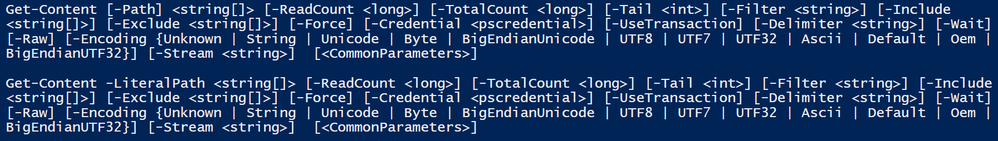
Understanding Help Syntax
Parameter Sets
You cannot mix and match these parameter sets
-Path only exists in the first parameter set
-LiteralPath only exists in the second parameter set

Slide 37
Understanding Parameters
[-Path] <string[]>
-Path is the name of the paramter. It will always start with a dash in front of it
The <string[]> is the value that this parameter must have
The square brackets surrounding the –Path indicates that it is a mandatory parameter
[-InstanceId <long>]
The Square brackets surrounding this entire strings means that it is an optional parameter
Another Example

Slide 38
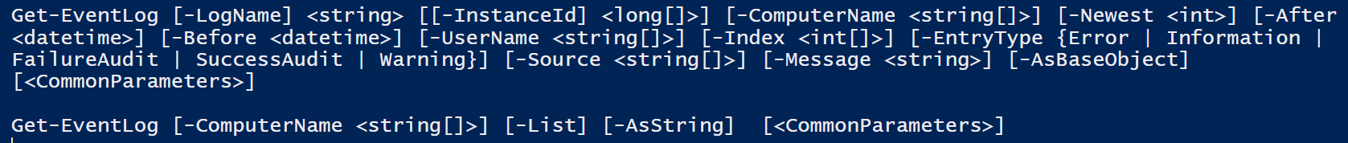
Understanding Parameters
2 Parameter Sets
[[-InstanceId] <long[]>]
This indicates that this is an optional parameter
[-LogName] <string>
Notice, that this parameter does not have square brackets around the entire thing.
This means that it is a mandatory parameter
<string> is the value/data type of that value
BUT! The ”square brackets” around –LogName mean that the parameter it self is optional but not the value.
This is because of Positional Parameters

Slide 39

Parameter Positioning
[-LogName] <string>
Because –LogName is listed first, this means that it sits in Position 0
Examples:
Get-EventLog –LogName Security –ComputerName ‘TEST-Computer’
Get-EventLog –LogName Security ‘TEST-Computer’
Get-EventLog Security –ComputerName ‘TEST-Computer’
Get-EventLog Security ‘TEST-Computer’
Get-EventLog ‘TEST-Computer’ Security
Get-EventLog -ComputerName ‘Test-Computer’ Security
Get-EventLog –ComputerName ‘TEST-Computer –LogName Security

Slide 40
Help Files
Update-Help
It’s that simple. This will go out and make sure you have the most recent help/man files for each CmdLet.
Save-Help
This will save your help files to a location, since Update-Help needs an internet connection
No Internet connected machines
Save-Help –DestinationPath ‘c:\some\path’
Update-Help –SourcePath ‘C:\some\path’

Slide 41
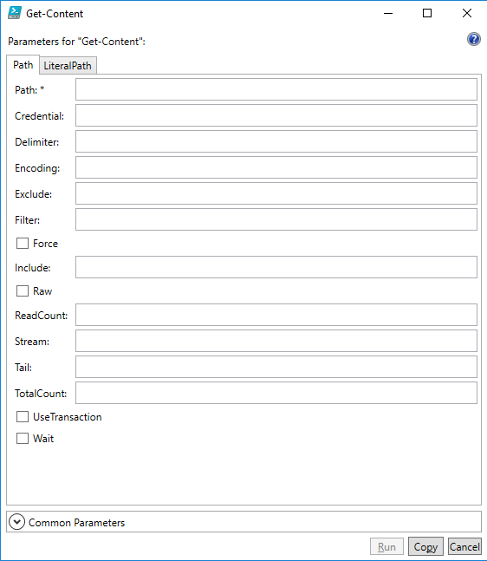
Show-Command
Show-Command –Name Get-EventLog
A GUI for filling out your parameters/values
It will have different windows for different parameter sets

Slide 42
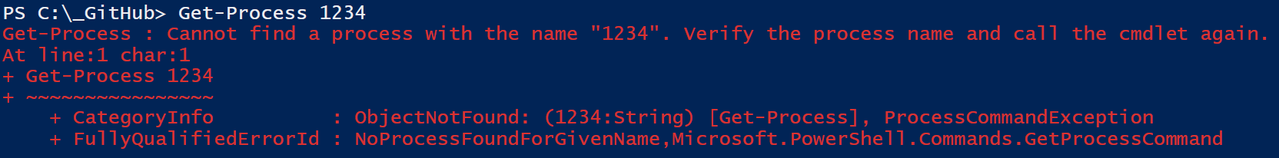
Reviewing Errors
Get-Process 1234
Cannot find a process with the name "1234". Verify the process name and call the cmdlet again.

Slide 43
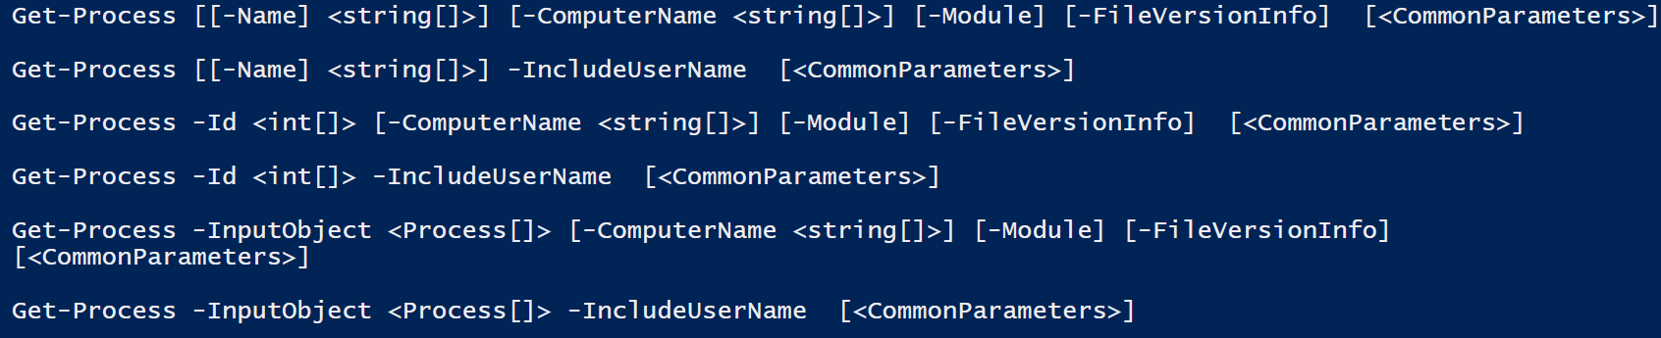
Reviewing Errors
But it’s in the first position?
Get-Help Get-Process
Yes, but the –Id field is not positional! There are no square brackets around it!

Slide 44
PSProviders

Slide 45
PSProvider’s
Cd hkcu:
Cd software
Get-PSProvider
This is a list of data points/storage that PowerShell can interpret into a file system like behavior

Slide 46
PSDrives

Slide 47
PSDrive’s
Get-PSDrive
Get-Command –Noun psdrive
New-PSDrive –Name Test –PSProvider filesystem –Root $env:USERPROFILE

Slide 48
Getting More Data
Notes:
Let’s do the following
Notepad C:\users\{username}\Desktop\test.txt
If prompted, select yes to creating the file
Type some gibberish in the file
Save and close it
Next
Get-ChildItem C:\users\{username}\Desktop\test.txt

Slide 49
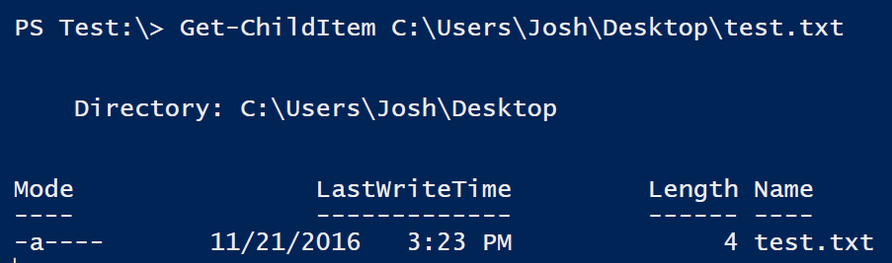
Get-ChildItem
But, that can’t be it?

Slide 50
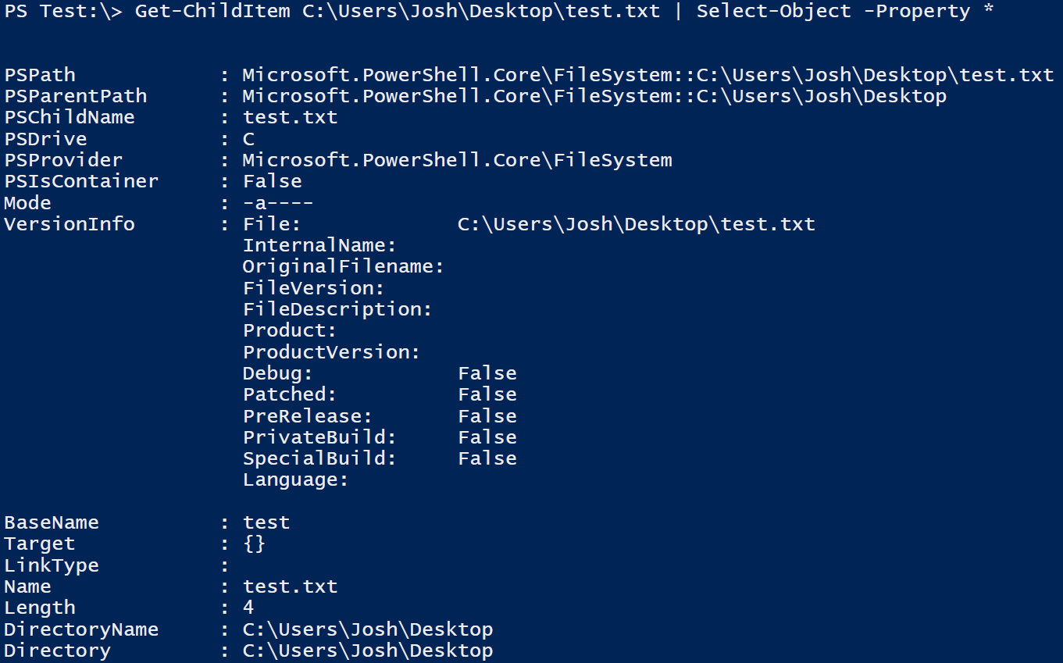
You’re Right!

Slide 51
Variables & Syntax

Slide 52
Variables
All variables in PowerShell begin with a $
$testvariable = ‘hello world’
$test__Me = ‘goodbye world’
${some long string can be a variable as well} = ‘hello again’
${even long strings can be integers} = ‘42’

Slide 53
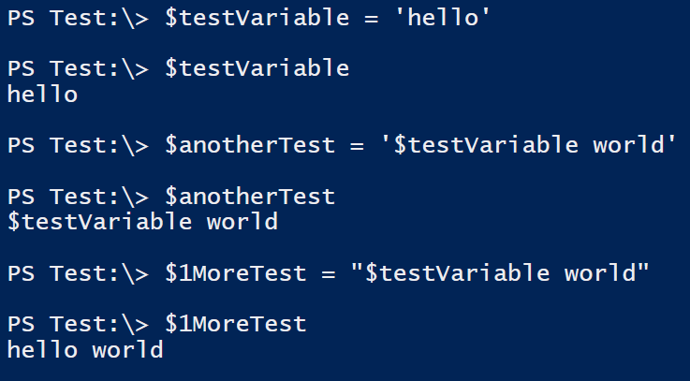
Quotes

Slide 54
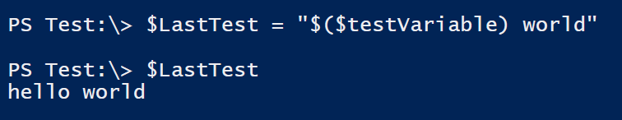
Quotes
Everything inside the parentheses is considered literal

Slide 55
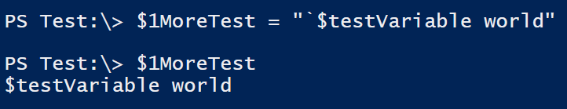
Backticks
In PowerShell, the ` (backtick) is an escape character

Slide 56
Understanding Arrays

Slide 57
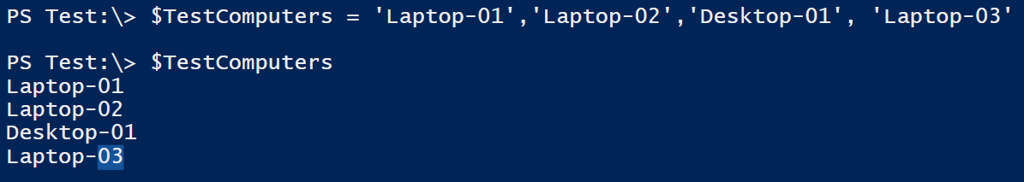
Arrays
In “almost” every programming/scripting language, values start at 0

Slide 58
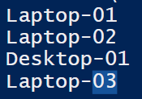
Arrays
$TestComputers is an array of Objects
$TestComputers.count = 4
To access the first computer
$TestComputers[0]
Laptop-01
To access the last computer
$TestComputers[3]
Laptop-03

Slide 59
Arrays
$TestComputers
Laptop-01
Laptop-02
Desktop-01
Laptop-03
$TestComputers[0]
$TestComputers[1]
$TestComputers[2]
$TestComputers[3]

Slide 60
Arrays and Quotes
Consider the following scenario: You are wanting to print out a specific object in an array. How would you do this?
$PrintValue = “Looking at $TestComputers[0]”
$PrintValue
$PrintValue = “Looking at $($TestComputers[0])”
$PrintValue

Slide 61
Datatypes & Operators

Slide 62
Strings
$hello = ‘hello’
$block = @”
This is a test of a
Multiple line string
“@

Slide 63
Operators
PowerShell will always interpret the left most data type when evaluating the solution.
The + operator can be used for both addition and concatenation
$a = 1
$b = ‘3’
$a + b = 4
$b + a = 31

Slide 64
Datatypes
[int]$input = Read-Host “What’s the ultimate number?”
Towel
Error
42
No Error
$input = Read-host “What’s the ultimate number?”
Towel

Slide 65
Hashtables

Slide 66
Hashtables
Starts with @{}
It’s basically a Key = Value pair inside the @{}
Example:
@{‘Key’=‘Value’}
Also called a Dictionary table
PowerShell = An automation scripting engine
Example:
@{‘PowerShell’=‘An automation scripting engine’}

Slide 67
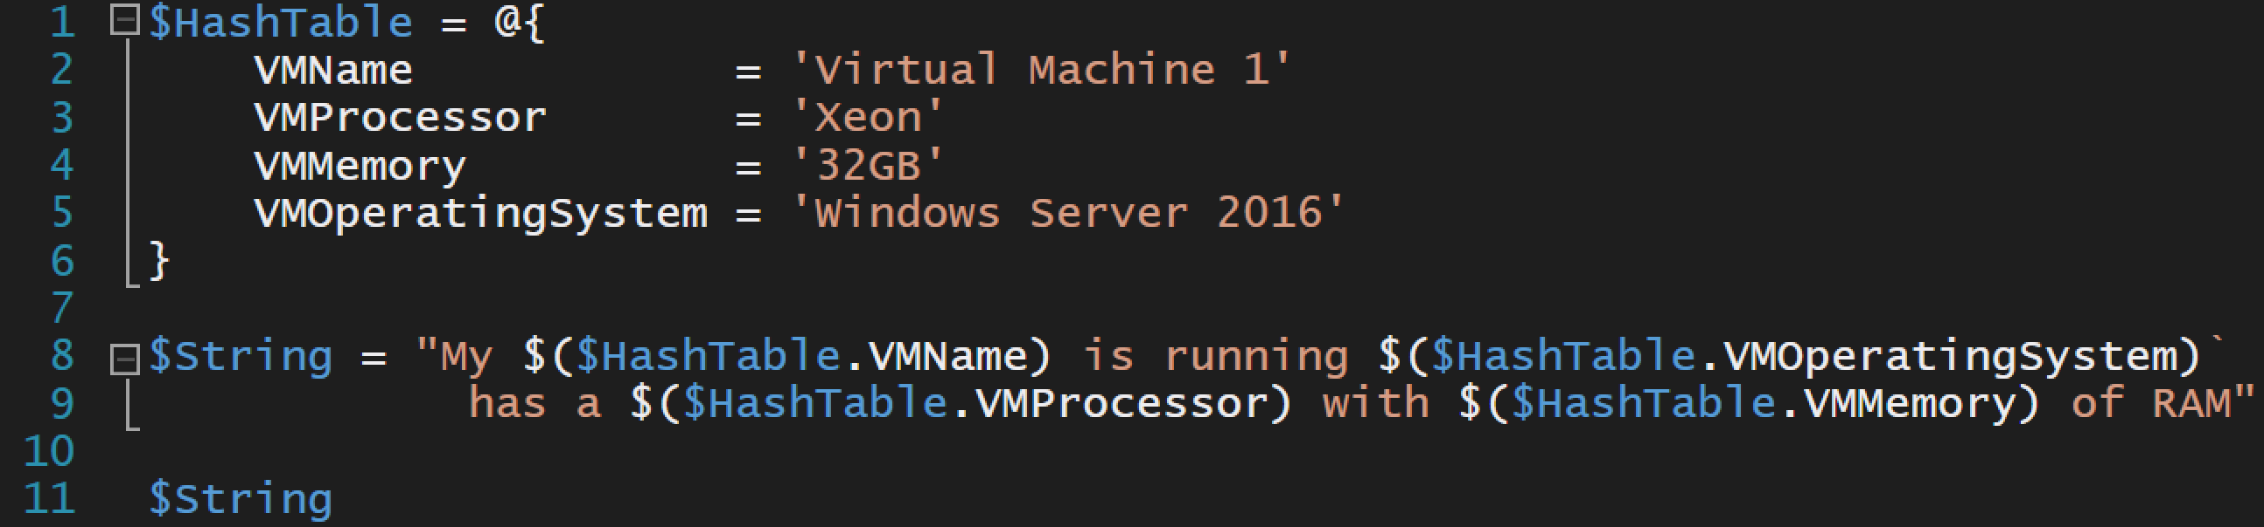

Hashtables

Slide 68
The Pipeline

Slide 69
Pipeline
Get-ChildItem C:\Windows\System32 | Where-Object { $_.BaseName -contains 'cmd' }

Slide 70
Pipeline Parameter Binding
Command A
Command B
Does any param of Command B accept that Type?
What is the TypeName of Command A’s output?
ByValue
Yes
No
Attach Command A properties to same-named Command B params
By Property Name
Do any params accept By Property Name?
No
Done
Yes

Slide 71
PowerShell Objects

Slide 72
“Object” Properties
Property
Property
Property
Name | DisplayName | Status
WinRM | Windows Remote Management | Started
MSSQLSERVER | SQL Server | Started
Alerter | Alerter | Stopped
Object
Object
Object

Slide 73
“Object” Methods

Slide 74
Basic Functions

Slide 75
WMI CIM

